Slide 1
Erastus Fillerup: A Life too Short
Teacher, Musician and Bridge Builder
October 6, 2012
Phil Stover – Deputy Superintendent
San Diego Unified School District

Slide 2
Erastus Fillerup: A Life too Short
Erastus Kruze Fillerup was born in Lake View, Utah on Feb 16, 1875 of Mormon immigrant parents from Denmark
He died in Pearson, Mexico on July 2, 1910 at 35 years of age
His wife of 11 years, Lulu Johnson (daughter of Elmer Wood Johnson) lived until 1969. They had six children, one of which he never saw. She remarried twice
His wife was his brother’s cousin by marriage. Erastus and his older brother Charles married cousins

Slide 3
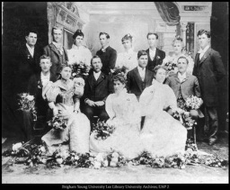
Erastus Fillerup: A Life too Short
Erastus graduated in 1895 from Brigham Young Academy Collegiate Normal School with a Bachelor of Pedagogy (B.Pd.) degree (Third row – first on left)

Slide 4
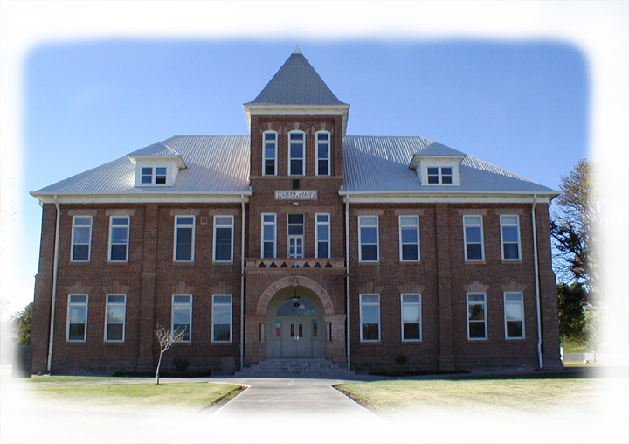
Erastus Fillerup: A Life too Short
Erastus taught music at both the Diaz Academy and the Juarez Stake Academy. His older brother Charles was the principal at both

Slide 5
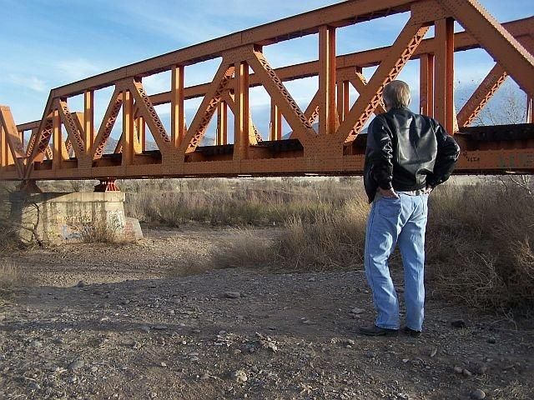
Erastus Fillerup: A Life too Short
As many teachers must, Fillerup had to supplement his income with summer work. He went to work for the Massillon Bridge Company of Massillon, Ohio helping build the railroad bridge over the San Miguel River in the new town of Pearson a few miles south of Colonia Juarez

Slide 6
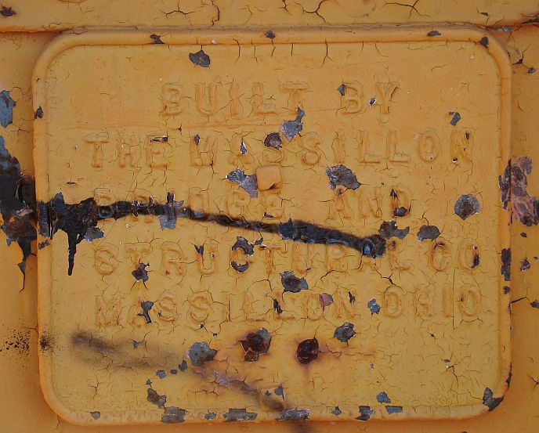
Erastus Fillerup: A Life too Short
The Massillon Bridge Company was founded in Massillon, Ohio in 1869
It merged with the Fort Pitt Bridge Works in 1930
It is unknown how many bridges it built for Mexican railroads
The company archives are at the University of Pittsburgh

Slide 7
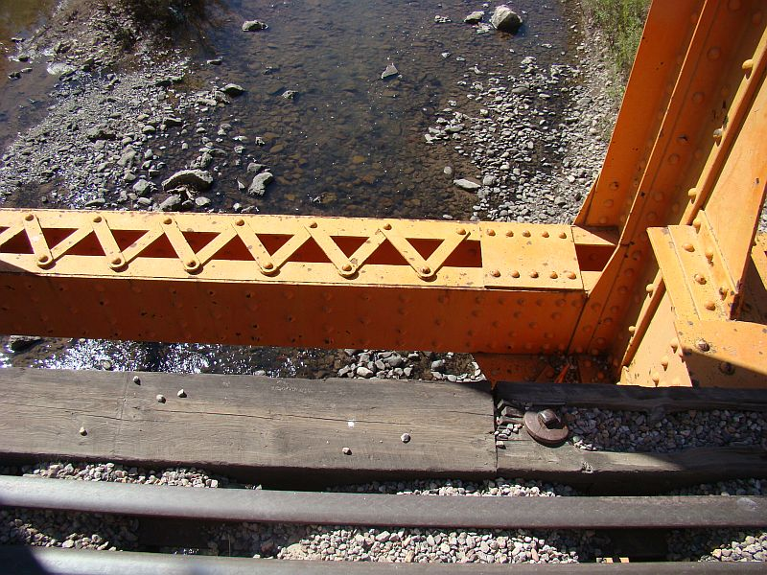
Erastus Fillerup: A Life too Short
Erastus fell from the bridge July 2, 1910 while working on a scaffolding 17 feet above the river. He fell head first, breaking both arms – dying without regaining consciousness – Deseret News July 15, 1910

Slide 8
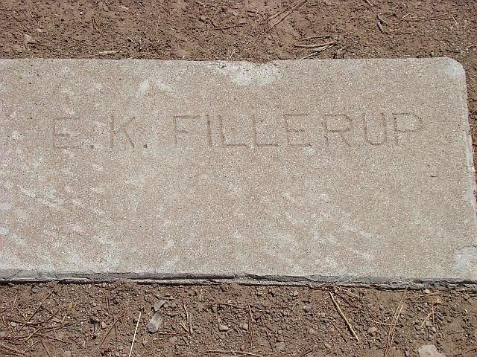
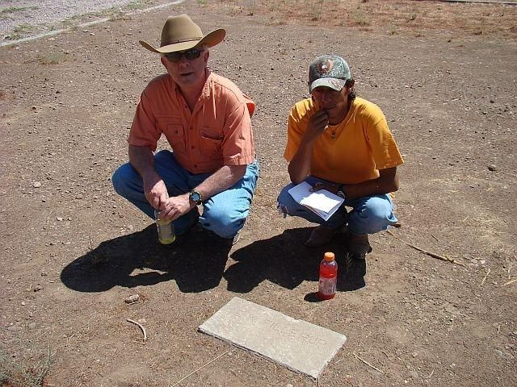
Erastus Fillerup: A Life too Short
Erastus Fillerup was buried two days later on the 4th of July in Colonia Juarez. His simple gravestone is unattended in stark contrast to many that surround it. We searched for hours before finding it
His son Albert was born three days later in Colonia Juarez

Slide 9
Erastus Fillerup: A Life too Short
Erastus Fillerup’s descendants populate many rural areas in Utah centered around the small town of Lapoint
Irva, his last child to die, was buried in Lapoint in 1987
Speaking of Erastus, The Deseret News informs us:
He was a man of unusual intelligence, highly educated, devoted to his family and an indefatigable worker for the good of the community in which he lived
Even though a young man, he was first counselor to Colonia Juarez Bishop Bentley
May he rest in peace!

